Slide 1

Predicting the Likelihood of a Patient Developing Prediabetes or Diabetes
Lauren Sweeney
Springboard – DSC
Capstone Project #3

Slide 2
Problem Statement
Our client, Very Fancy Hospital (”VFH”), is the largest hospital network in Northeastern Pennsylvania. VFH is also one of the leading hospitals for diabetes research, and patients from all over the country seek treatment from VFH for this chronic disease
VFH is interested in determining whether it’s possible to predict which of their current patients are likely to develop prediabetes or diabetes
Dataset includes 253,680 patient survey responses from patients who are diabetic, prediabetic, or nondiabetic (or, alternatively, only experienced gestational diabetes)
We determined which variables were most important for predicting the likelihood of developing prediabetes or diabetes by calculating the highest Accuracy, Precision, & Recall scores by building machine learning models

Slide 3
Dataset Variables
Variable Name | Information re Variable
Diabetes_binary | 0 = no diabetes 1 = prediabetes or diabetes
HighBP | 0 = no high blood pressure 1 = high blood pressure
HighChol | 0 = no high cholesterol 1 = high cholesterol
CholCheck | 0 = they have not had their cholesterol checked in the last 5 years 1 = they have had it checked
BMI | Body mass index, numerical
Smoker | 0 = they have not smoked at least 100 cigarettes in their entire life 1 = they have
Stroke | 0 = they have not had a stroke 1 = they have had a stroke
HeartDiseaseorAttack | 0 = they do not have coronary heart disease (CHD) or myocardial infarction (MI) 1 = they do have heart disease

Slide 4
Dataset Variables
Variable Name | Information re Variable
PhysActivity | 0 = they have not performed physical activity in the last 30 days (excluding their job) 1 = they have performed physical activity
Fruits | 0 = they do not consume fruit at least once per day 1 = they do consume fruit at least once per day
Veggies | 0 = they do not consume vegetables at least once per day 1 = they do consume vegetables at least once per day
HvyAlcoholConsump | 0 = they do not drink a high amount of alcohol per week 1 = they do High amount = at least 14 drinks for men and 7 for women
AnyHealthcare | 0 = they do not have any kind of health care coverage 1 = they do have health care coverage
NoDocbcCost | 0 = there was not a time within the past 12 months where they could not see a doctor due to cost 1 = there was a time when they could not see a doctor
GenHlth | Rate general health on a scale, where 1 = excellent, 2 = very good, 3 = good, 4 = fair, 5 = poor

Slide 5
Dataset Variables
Variable Name | Information re Variable
MentHlth | How many days they experienced poor mental health in the last 30 days
PhysHlth | How many days they experienced either illness or injury in last 30 days
DiffWalk | 0 = they do not have a serious difficulty walking or climbing stairs 1 = they do have a serious difficulty
Sex | 0 = female 1 = male
Age | 1 = 18 to 24, 2 = 25 to 29, 3 = 30 to 34, 4 = 35 to 39, 5 = 40 to 44, 6 = 45 to 49, 7 = 50 to 54, 8 = 55 to 59, 9 = 60 to 64, 10 = 65 to 69, 11 = 70 to 74, 12 = 75 to 79, 13 = 80+
Education | 1 = never attended school (or only kindergarten), 2 = grades 1 through 8, 3 = grades 9 through 11, 4 = grades 12 or GED, 5 = college 1 to 3 years, 6 = college 4 years or more
Income | 1 = less than $10k, 2 = less than $15k, 3 = less than $20k, 4 = less than $25k, 5 = less than $35k, 6 = less than $50k, 7 = less than $75k, 8 = $75k+

Slide 6
Determining Project Success & Constraints
Success:
Determining which variables impact the likelihood of a patient developing prediabetes or diabetes
VFH can best tolerate False Positives than False Negatives, therefore, we needed to determine which model had the highest Recall
Constraints:
There is also a genetic component to diabetes; however, the genetic makeup of the patients surveyed was not considered

Slide 7
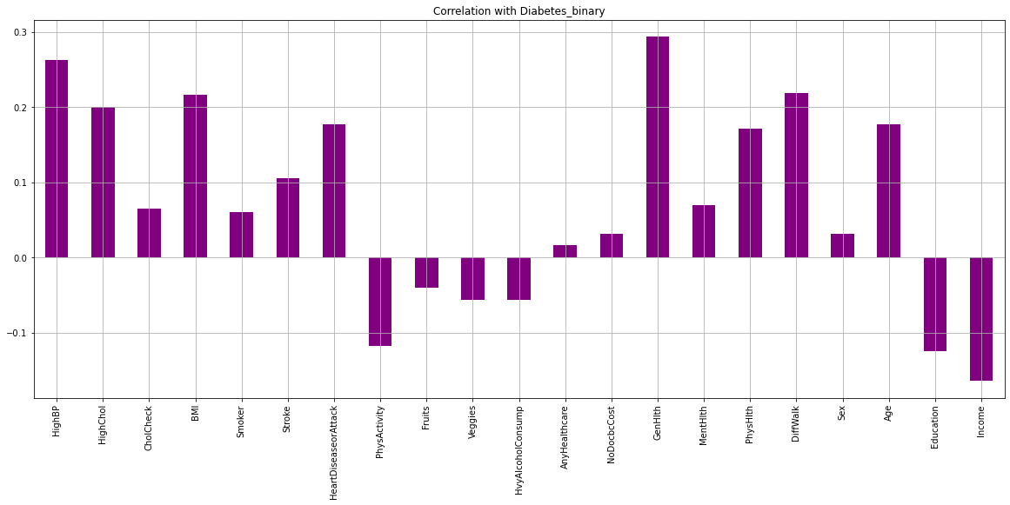
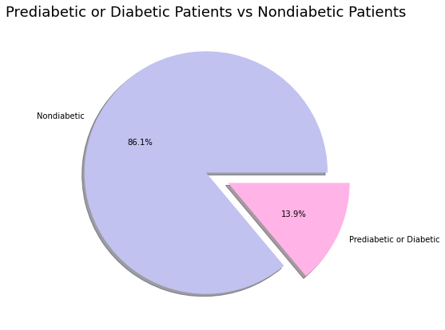
Exploratory Data Analysis

Slide 8
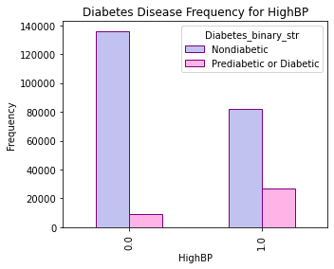
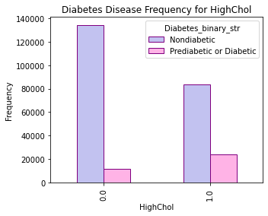
Exploratory Data Analysis

Slide 9
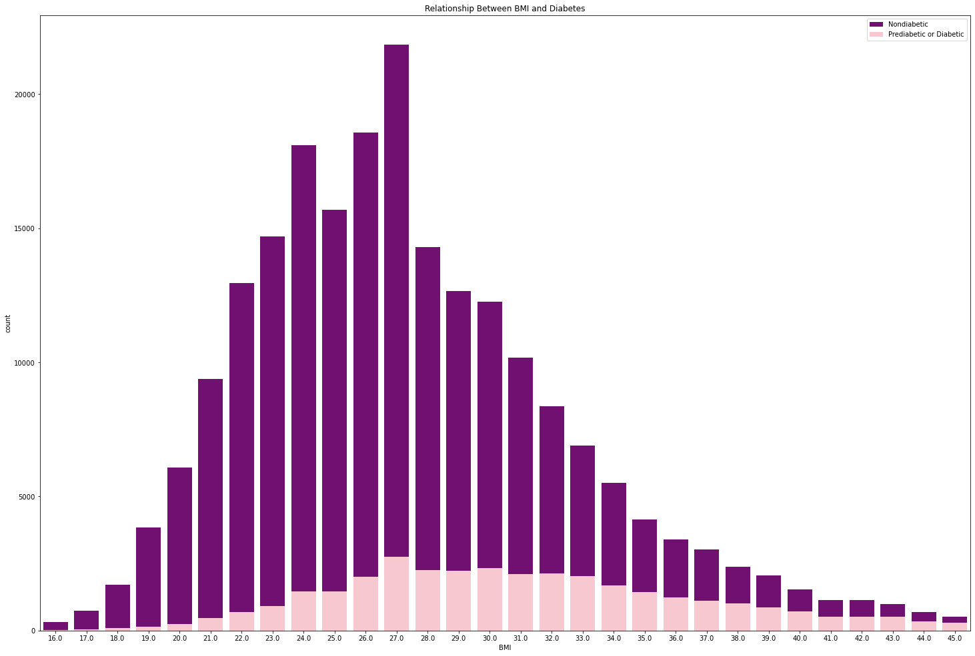
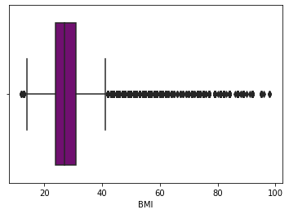
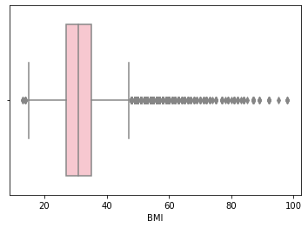
Exploratory Data Analysis

Slide 10
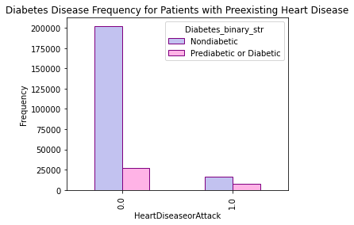
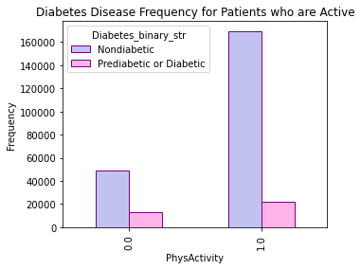
Exploratory Data Analysis

Slide 11
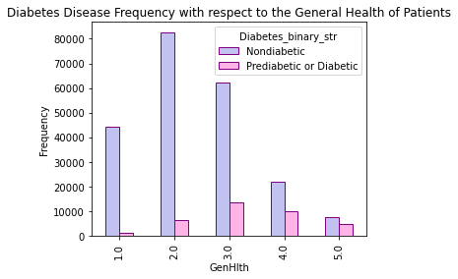
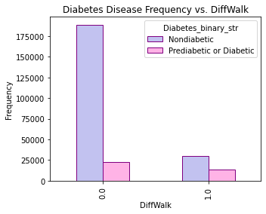
Exploratory Data Analysis

Slide 12
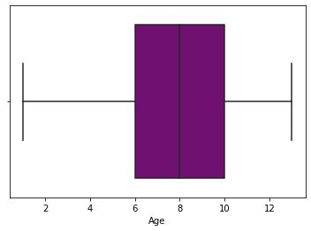
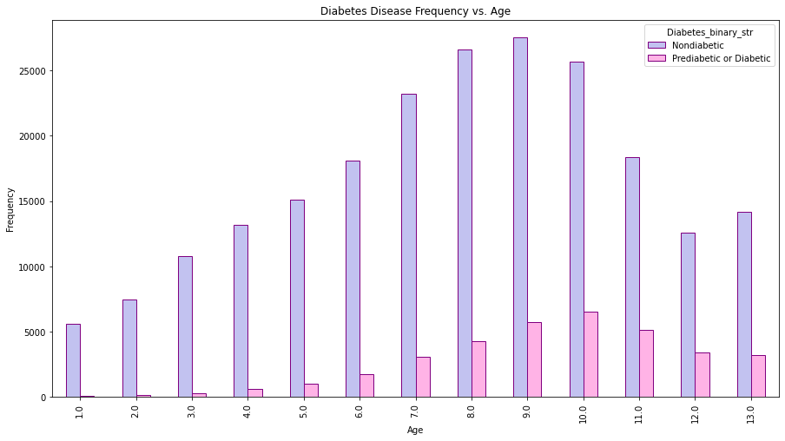
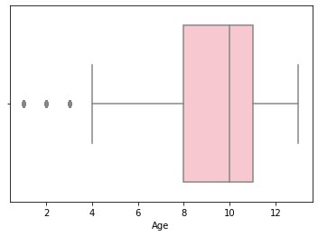
Exploratory Data Analysis

Slide 13
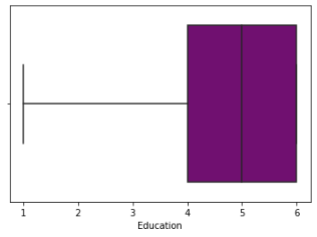
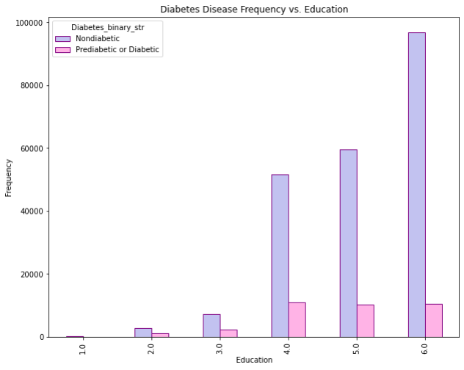
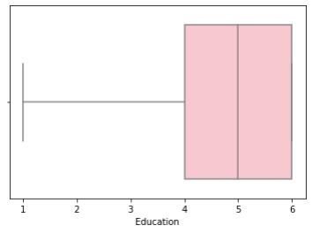
Exploratory Data Analysis

Slide 14
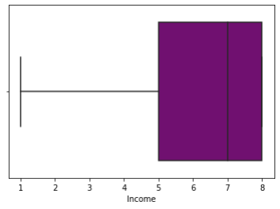
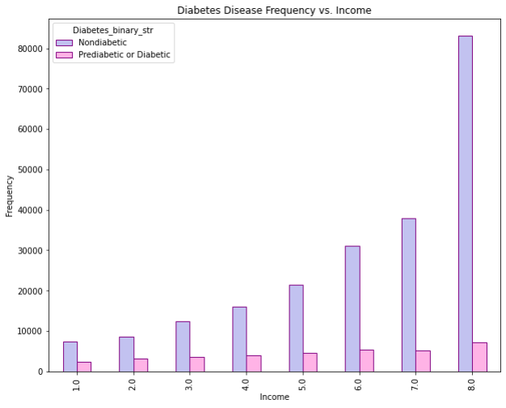
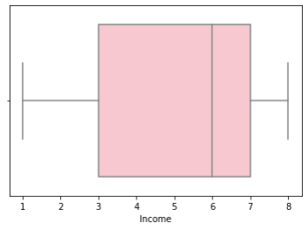
Exploratory Data Analysis

Slide 15
Model Selection
Model | Test Precision | Test Recall | Test F1-Score
Logistic Regression – RUS | 0.31 | 0.77 | 0.44
Logistic Regression – SMOTE | 0.31 | 0.76 | 0.44
Logistic Regression – Balanced | 0.31 | 0.77 | 0.44
Random Forest – RUS | 0.29 | 0.79 | 0.43
Random Forest – SMOTE | 0.47 | 0.20 | 0.28
Random Forest – Balanced | 0.46 | 0.16 | 0.23
XGBoost – RUS | 0.29 | 0.80 | 0.43
XGBoost – SMOTE | 0.55 | 0.18 | 0.28
XGBoost – Balanced | 0.31 | 0.77 | 0.44
In total, we created 9 models
We performed hyperparameter tuning on the Random Forest – RUS and XGBoost – RUS models
As a result, the XGBoost – RUS model slightly outperformed the Random Forest model
Thus, we determined that the best model for the needs of our client was the XGBoost model using random under sampling, due to its test recall

Slide 16
Conclusions & Future Work
What did we learn during exploratory data analysis?
What did we learn after building machine learning models?
Future work:
If a patient falls into a risk category based on their lifestyle, encourage those patients to adopt a healthier lifestyle
VFH could also perform a similar analysis on patients after they have enacted lifestyle changes to determine whether those changes sufficiently decreased their likelihood of developing prediabetes or diabetes
VFH could also request another patient survey in approximately 10 years to determine whether the risk categories for developing prediabetes or diabetes have changed

Slide 17
Thank You!

